Slide 1
Continuous Random Variables

Slide 2
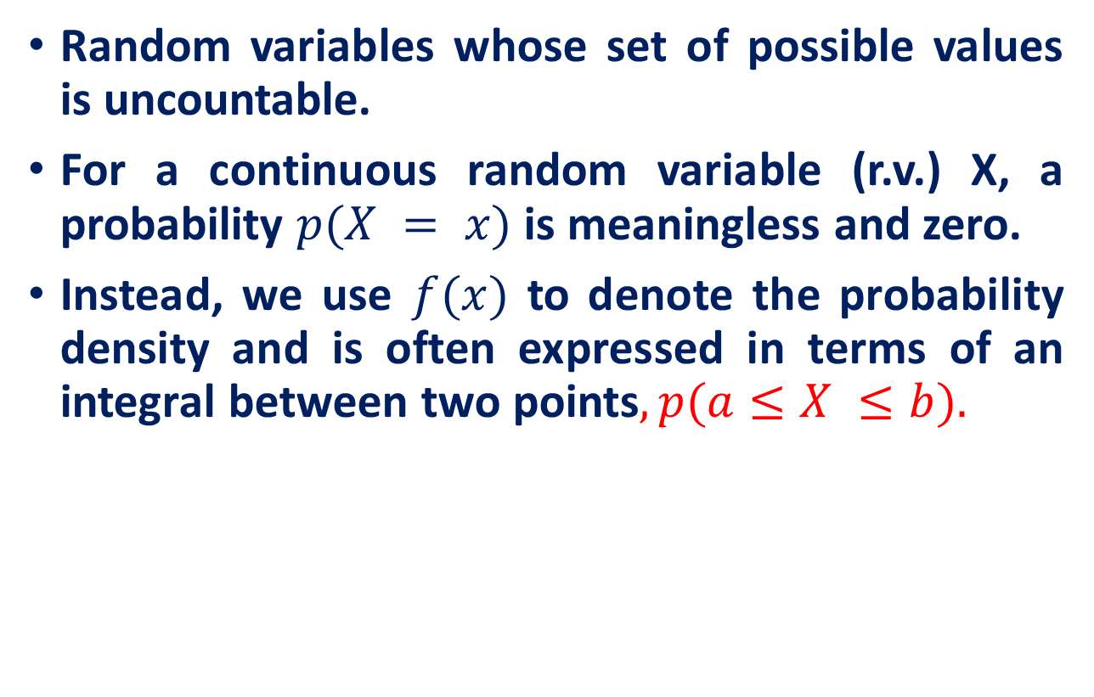
Continuous Random Variables

Slide 3
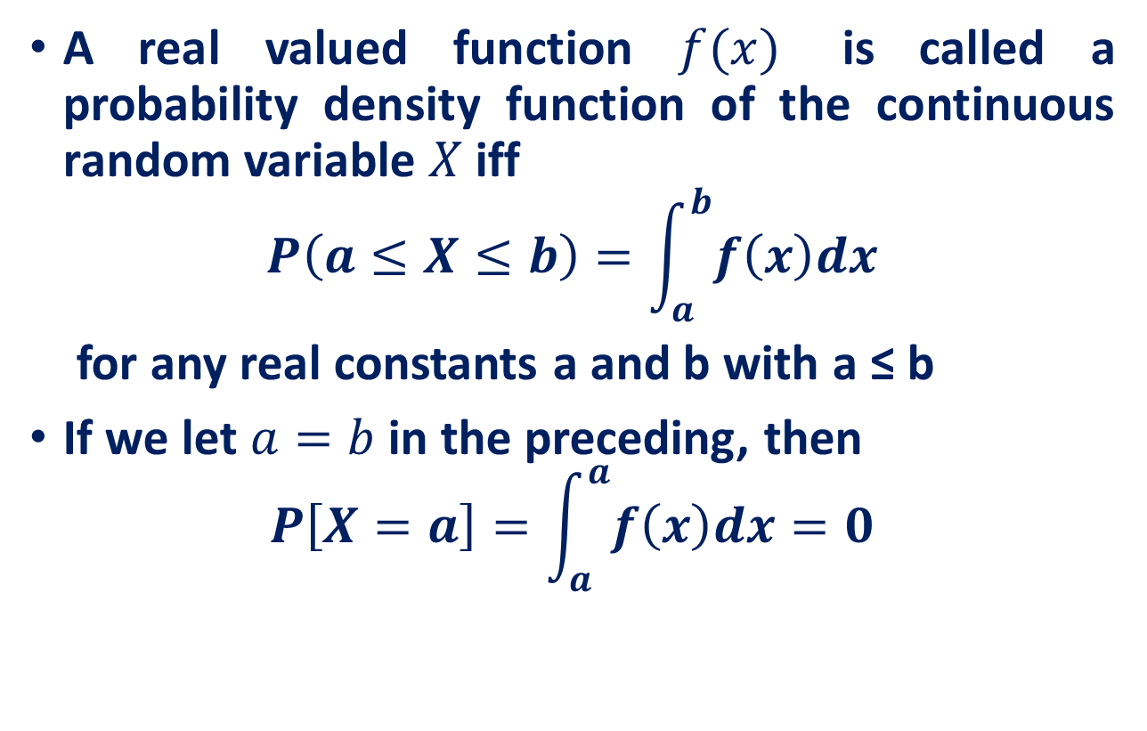
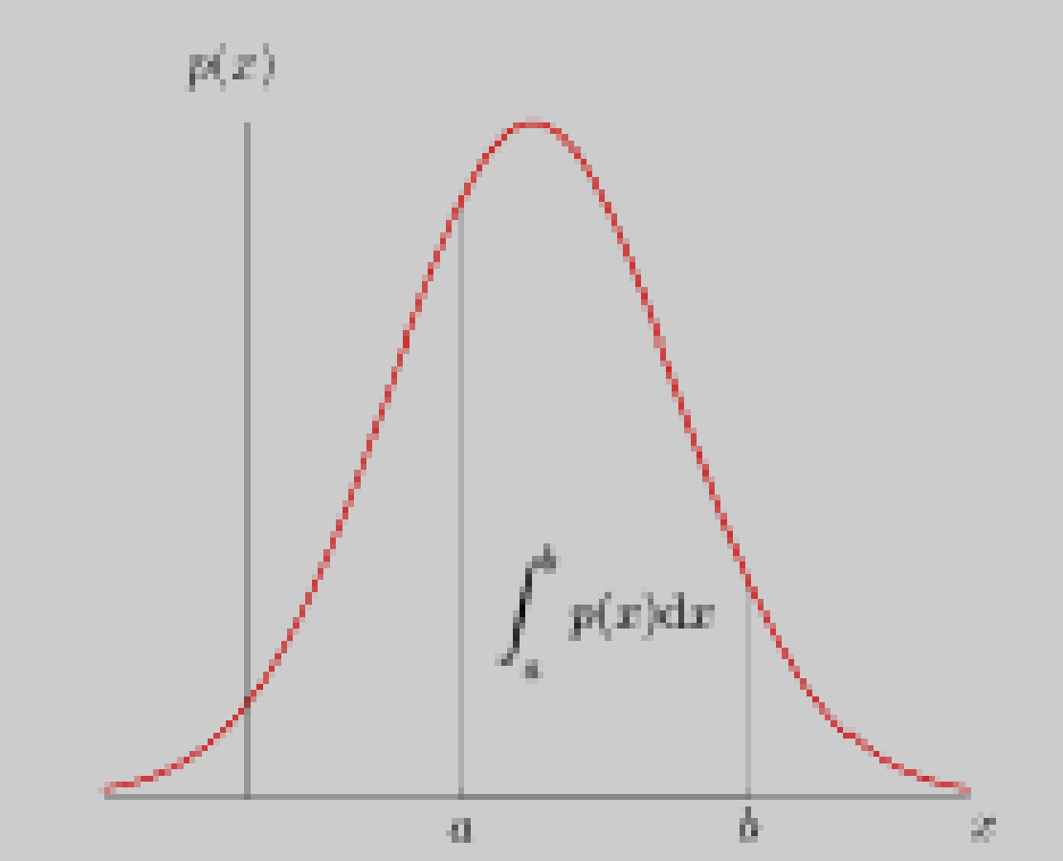
Continuous Random Variables
this equation states that the probability that a continuous random variable will assume any particular value is zero.

Slide 4
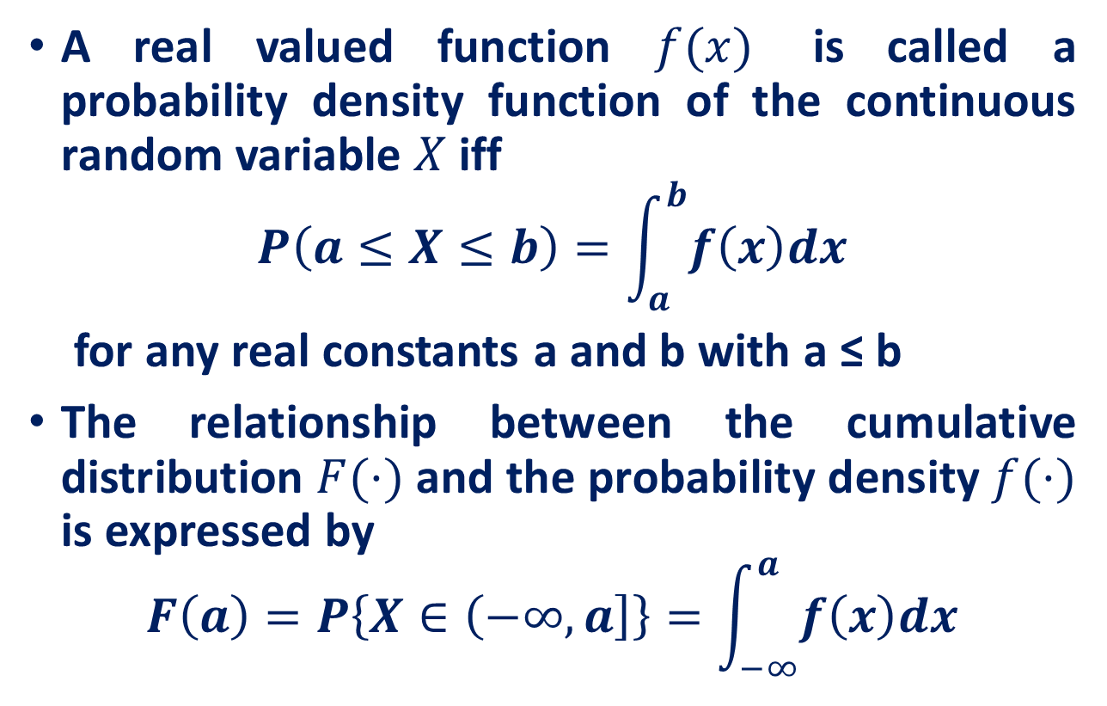
Continuous Random Variables

Slide 5
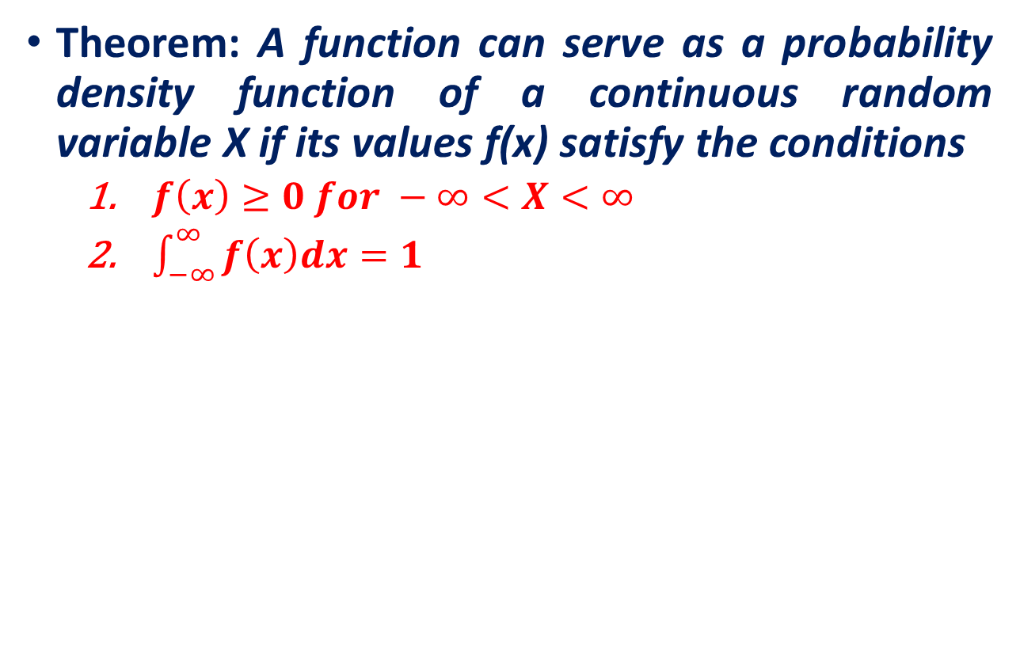
Continuous Random Variables

Slide 6
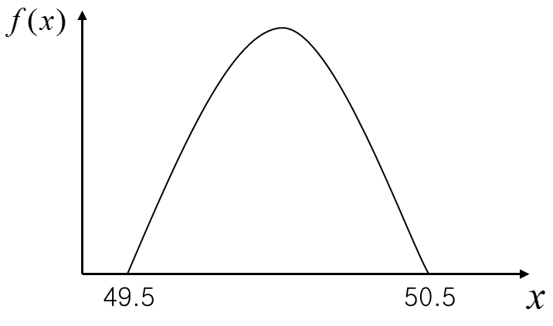
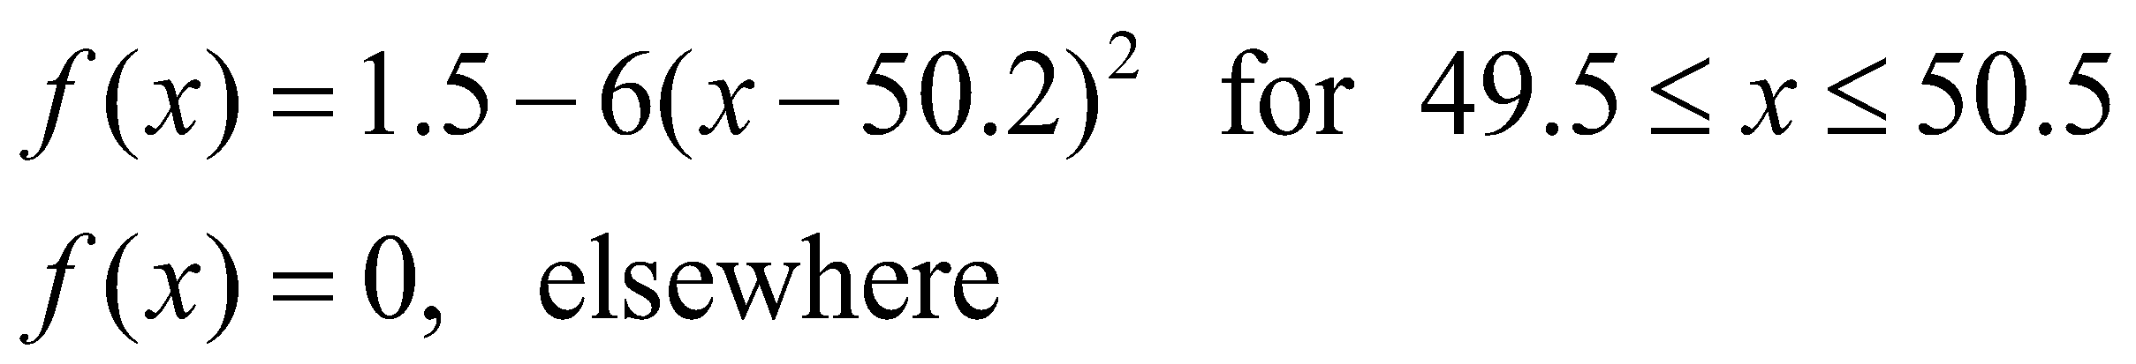
Continuous Random Variables
Example: Metal Cylinder Production
Suppose that the random variable x is the diameter of a randomly chosen cylinder manufactured by the company. Since this random variable can take any value between 49.5 and 50.5, it is a continuous random variable.
Suppose that the diameter of a metal cylinder has a p.d.f
Is this valid p.d.f.?

Slide 7
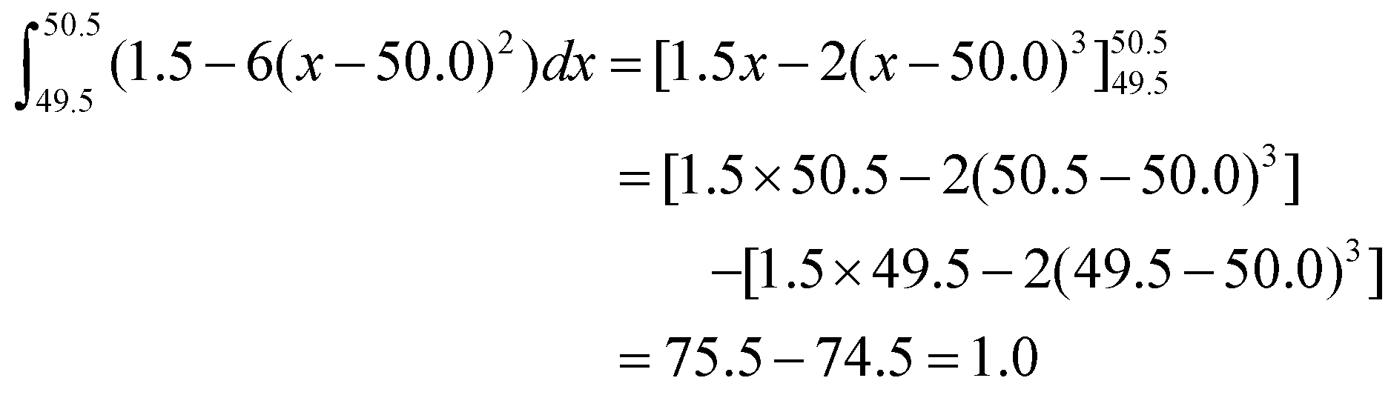
Continuous Random Variables

Slide 8
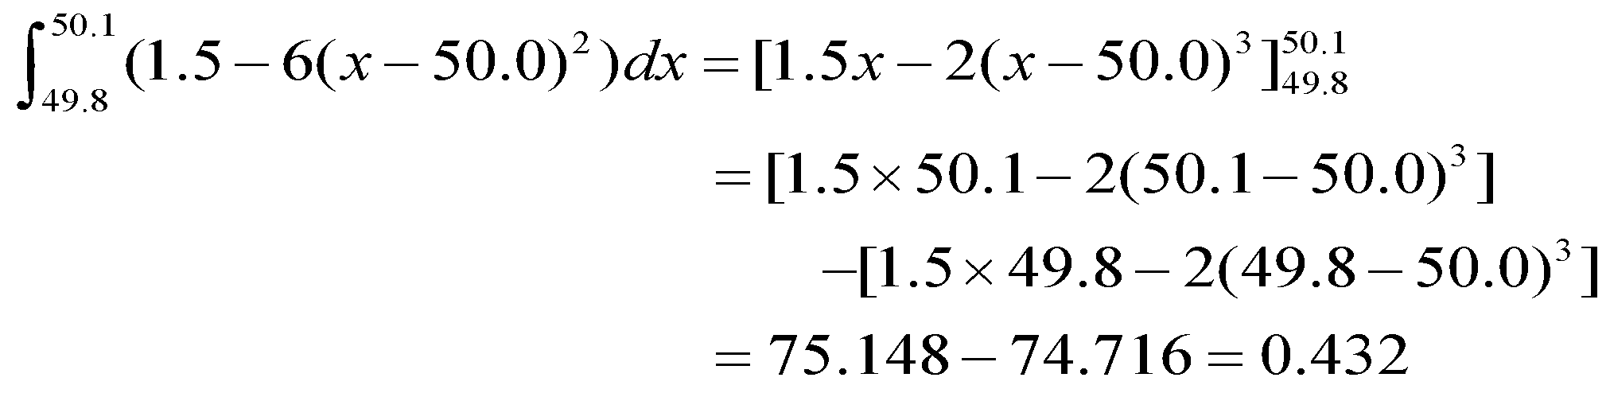
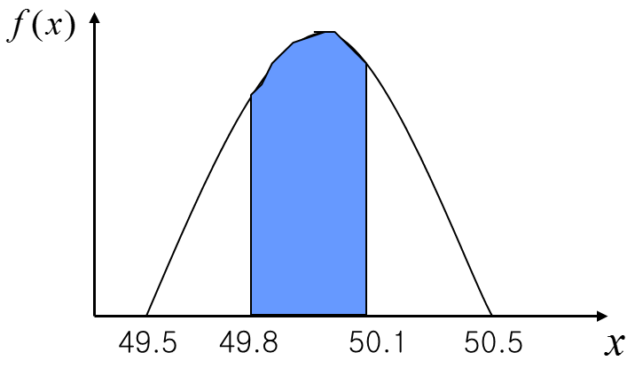
Continuous Random Variables
The probability that a metal cylinder has a diameter between 49.8 and 50.1 mm can be calculated to be

Slide 9
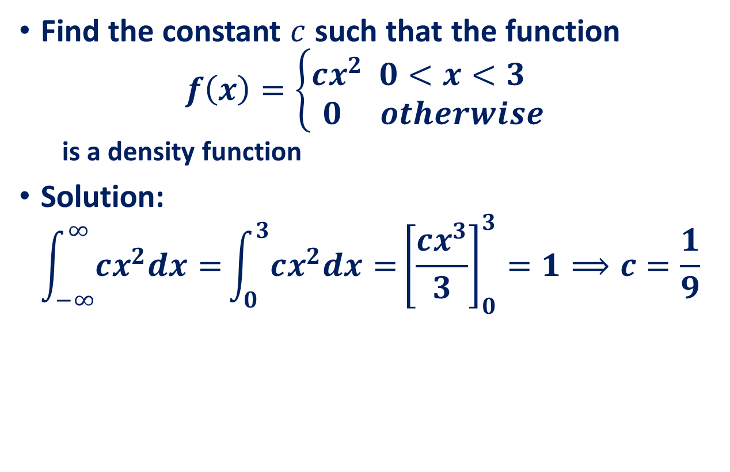
Continuous Random Variables

Slide 10
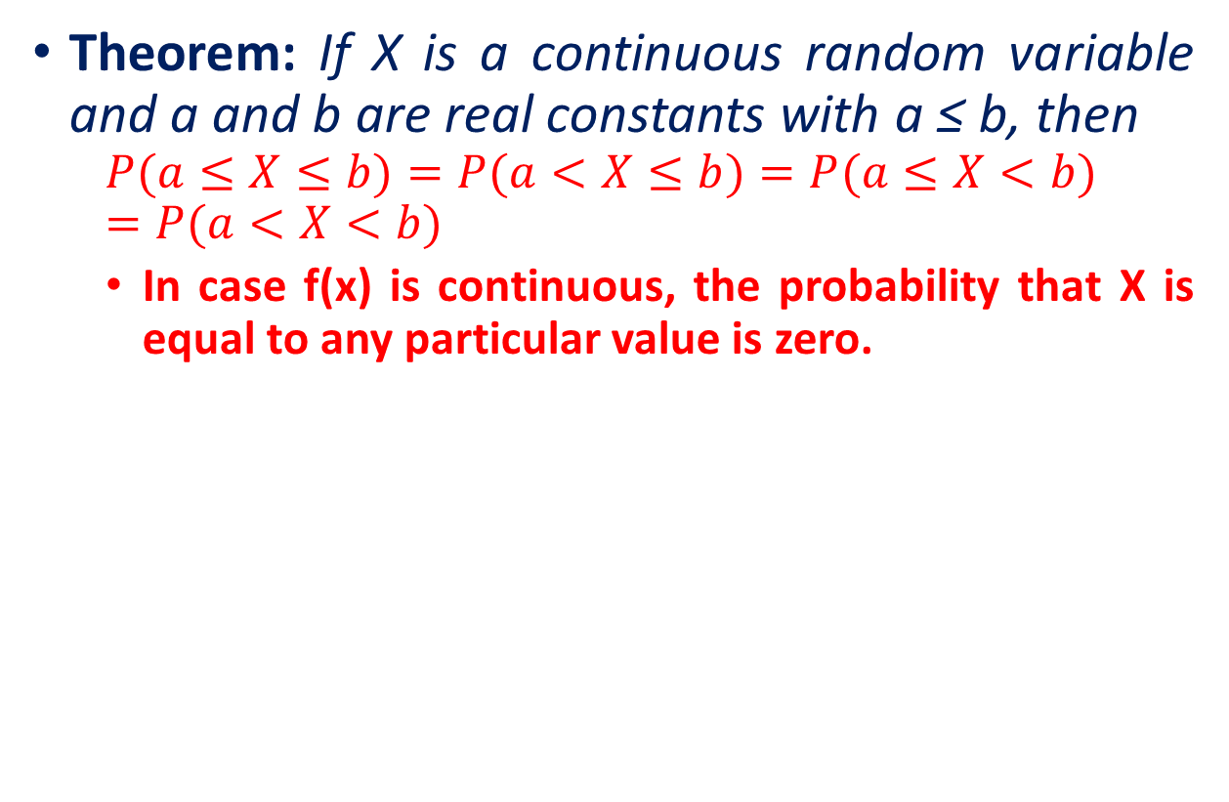
Continuous Random Variables

Slide 11
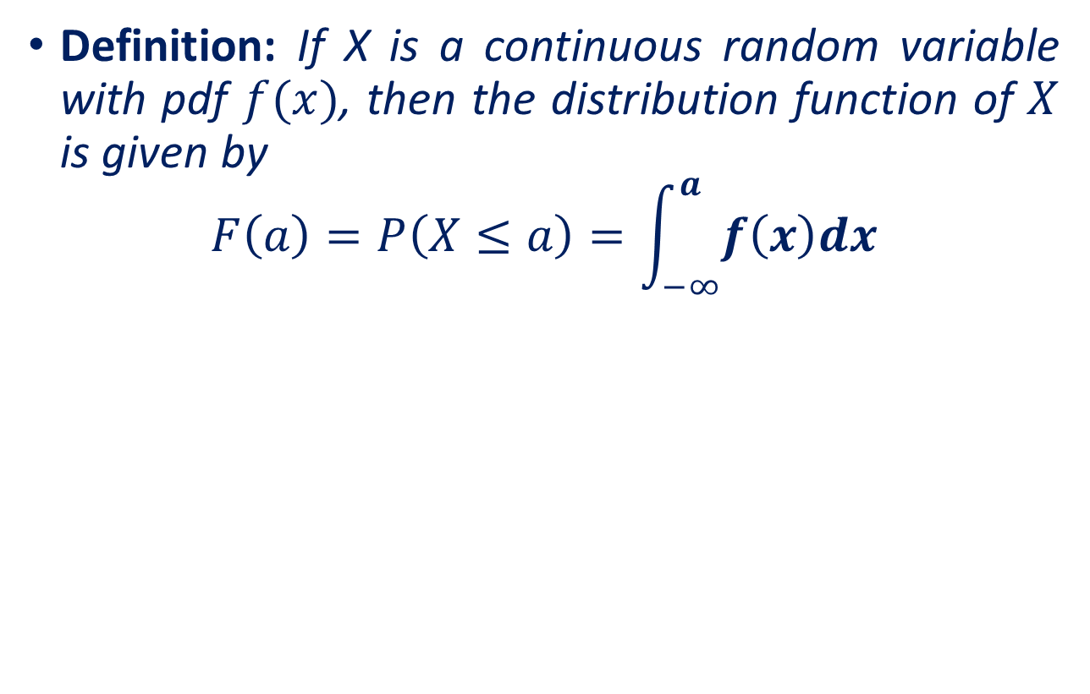
Cumulative Distribution Function

Slide 12
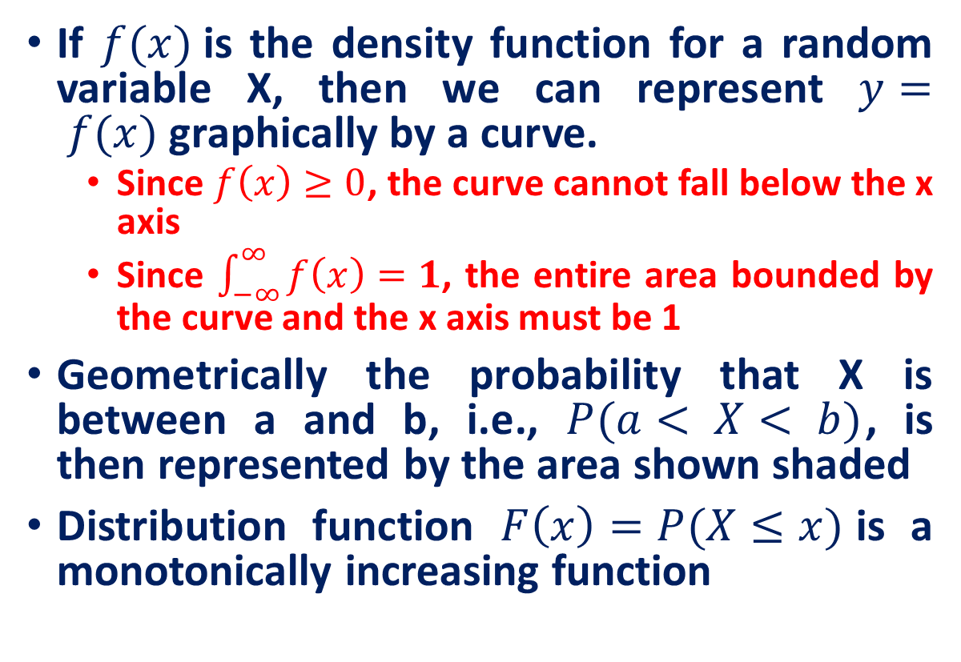
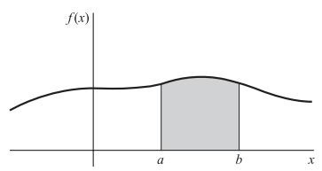
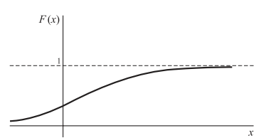
Graphical Interpretations

Slide 13
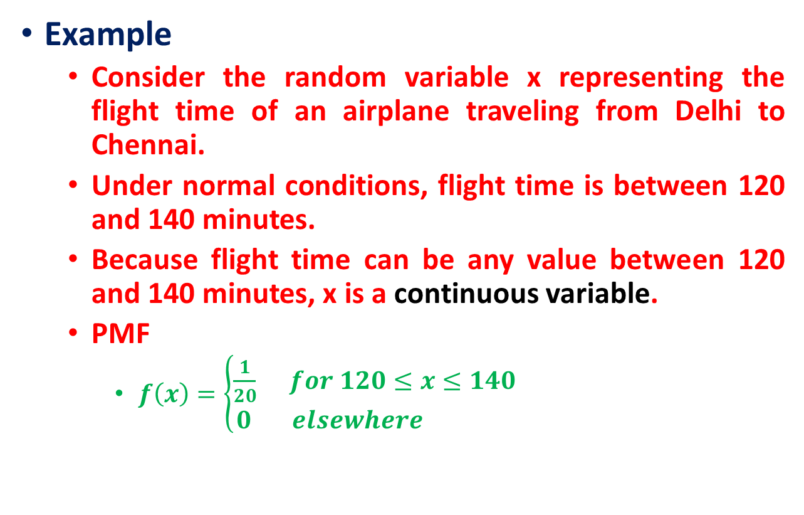

The Uniform Random Variable
With every one-minute interval being equally likely, the random variable x is said to have a uniform probability distribution
https://www.probabilitycourse.com/chapter4/4_2_1_uniform.php

Slide 14
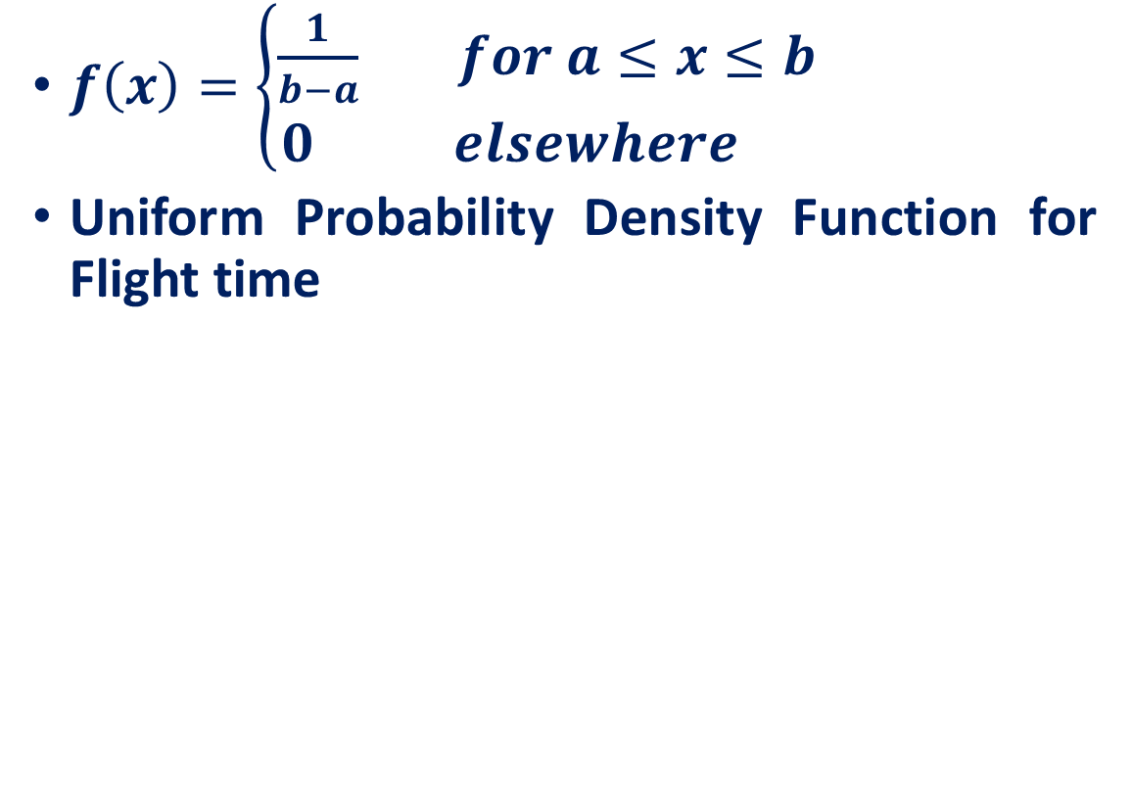

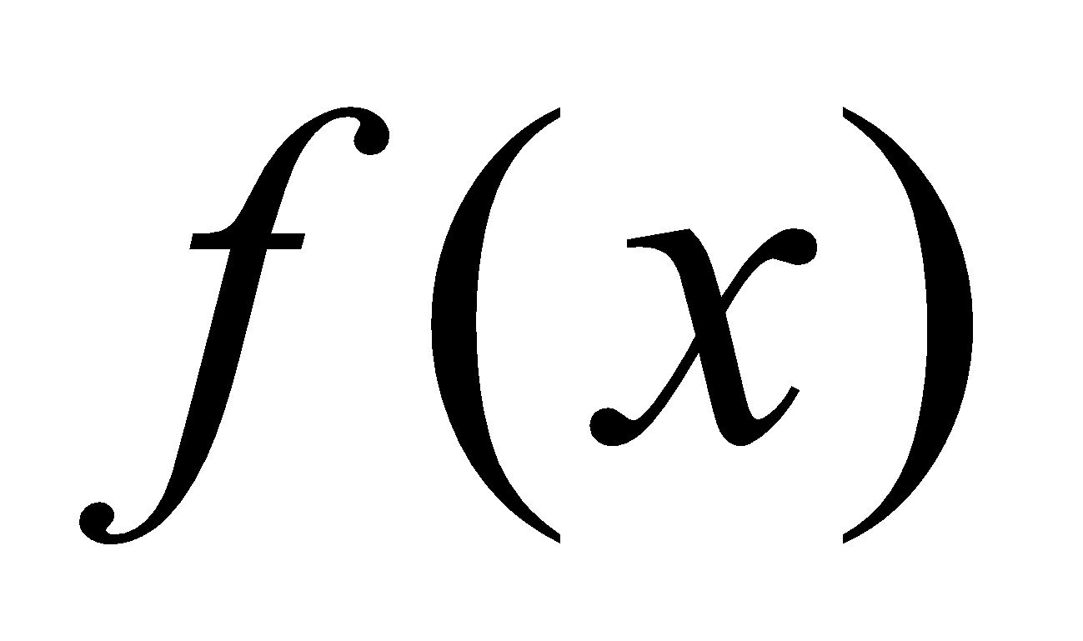
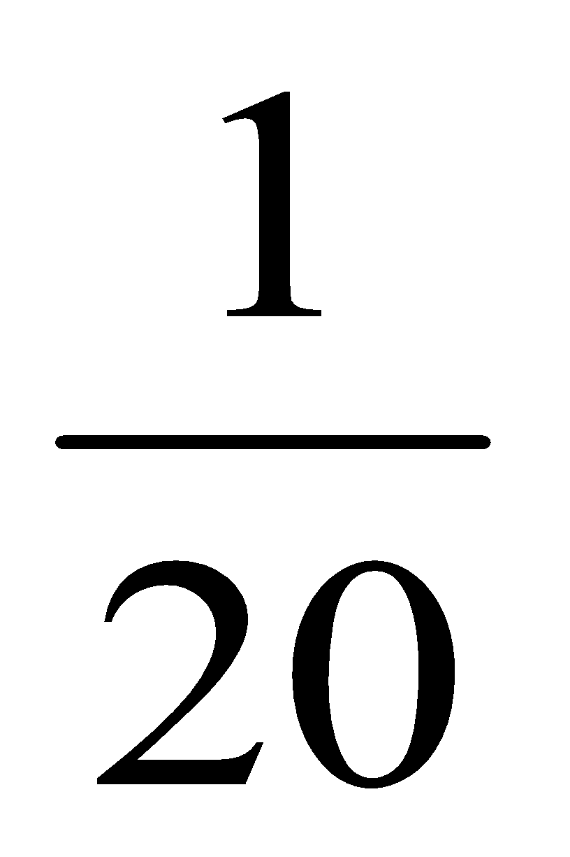

The Uniform Random Variable
The shaded area indicates the probability the flight will arrive in the interval between 120 and 140 minutes
120
125
130
135
140

Slide 15
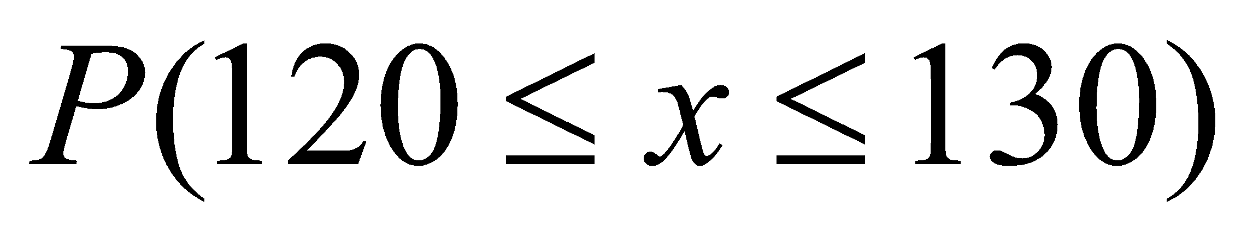
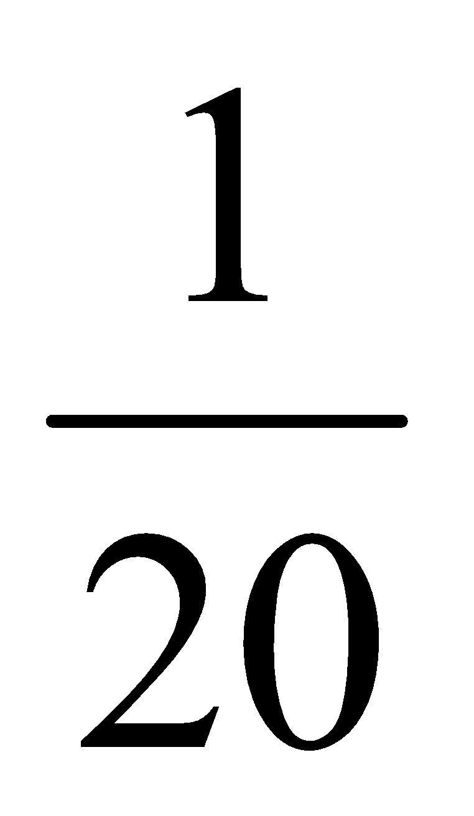
Probability as an Area
Question: What is the probability that arrival time will be between 120 and 130 minutes—that is:
10
120
125
130
135
140

Slide 16
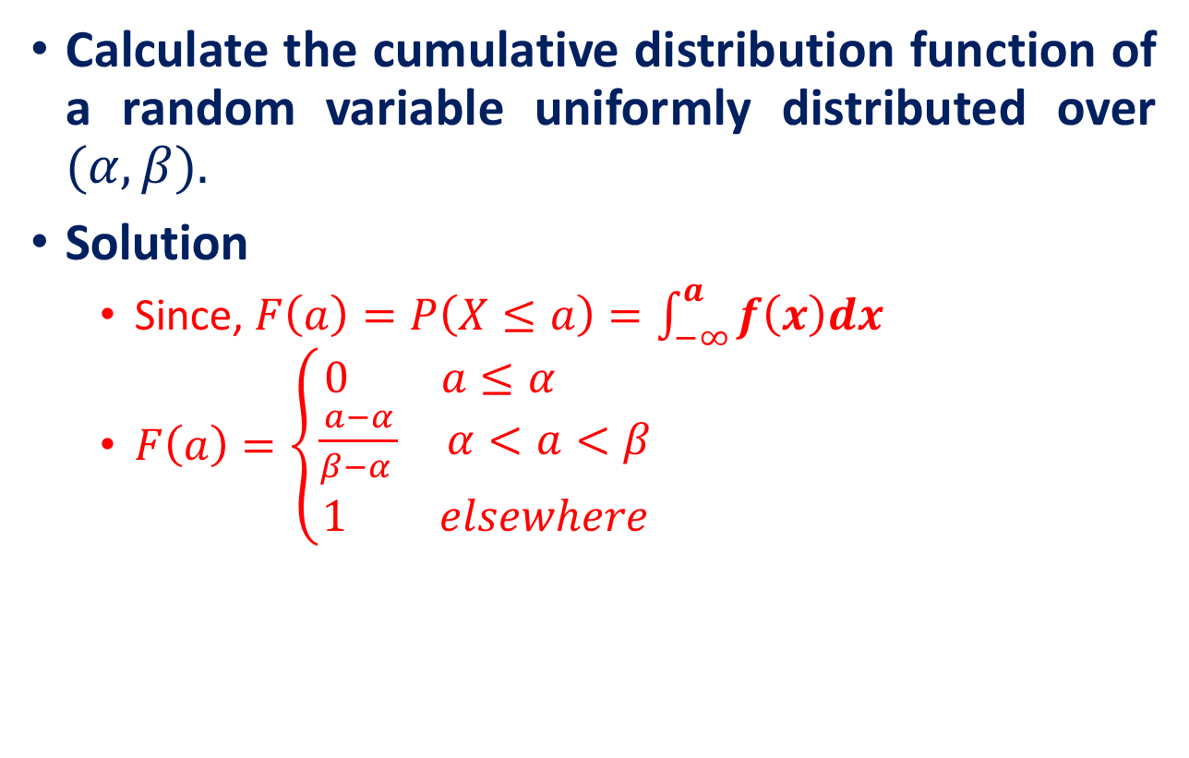
The Uniform Random Variable

Slide 17
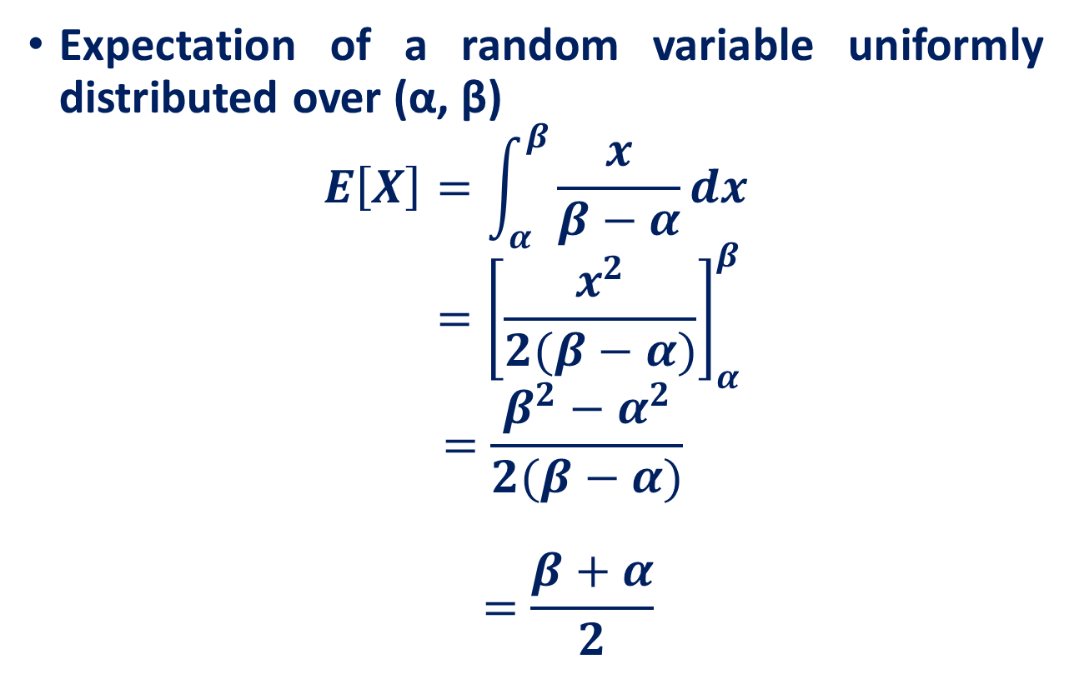
Expectation of a Uniform Random Variable

Slide 18
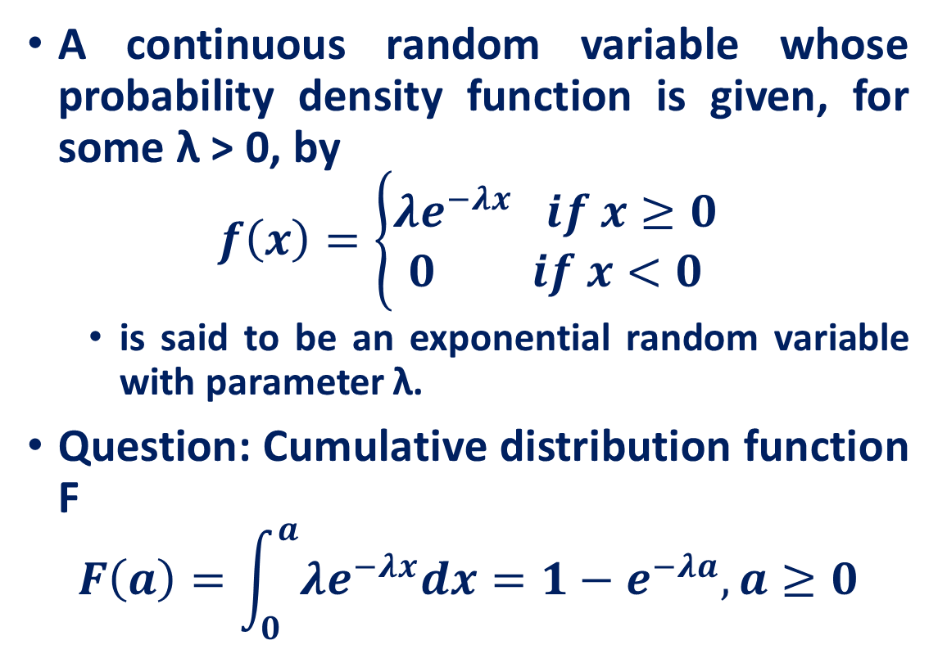
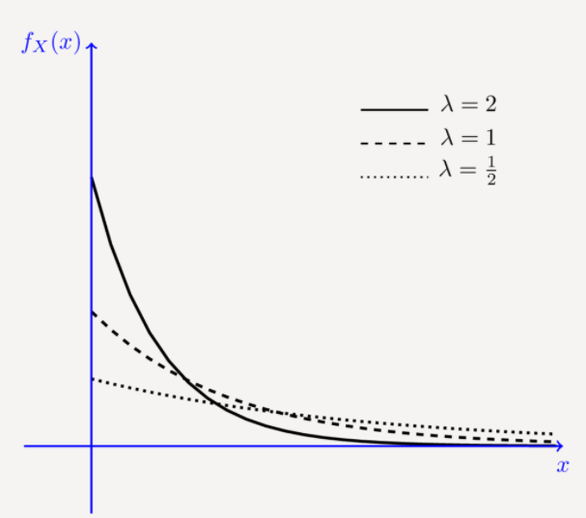
Exponential Random Variables
https://www.probabilitycourse.com/chapter4/4_2_2_exponential.php

Slide 19
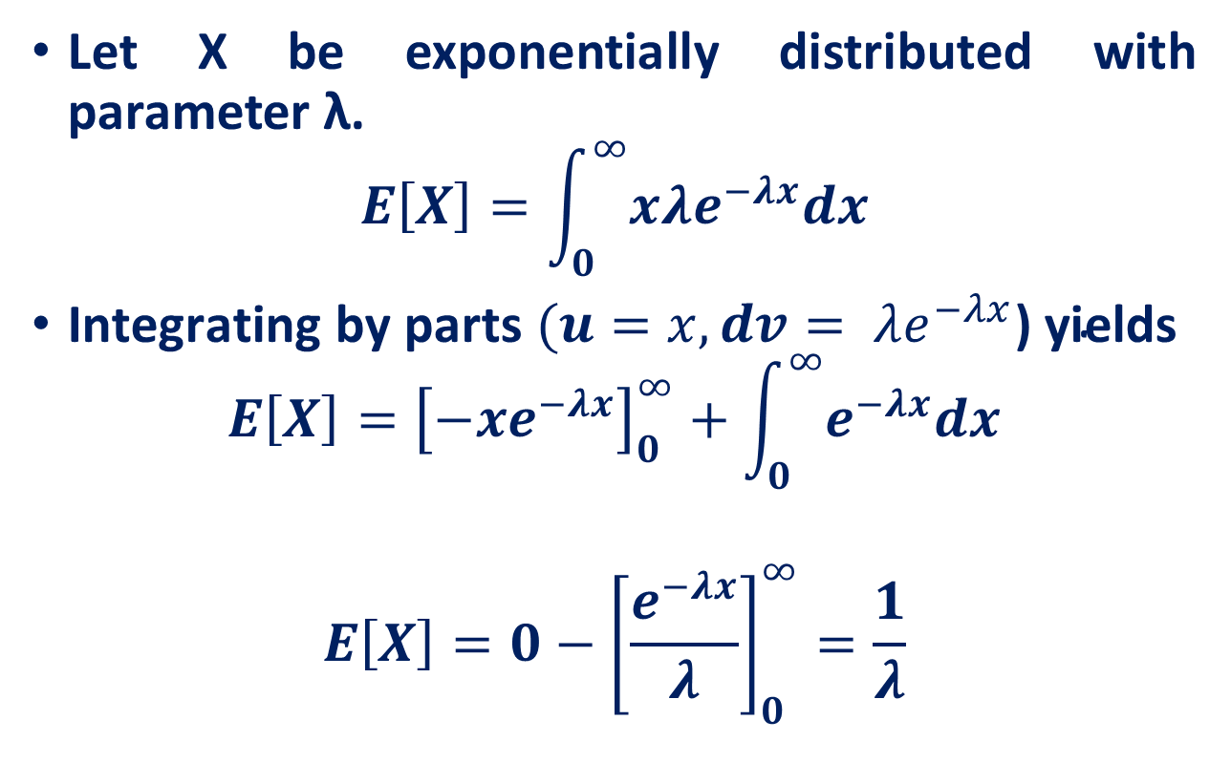
Expectation of Exponential Random Variable

Slide 20
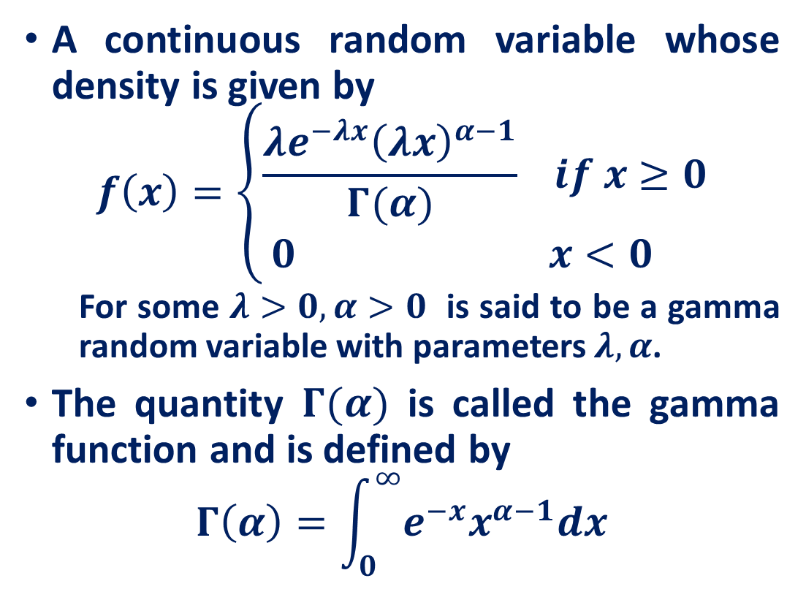
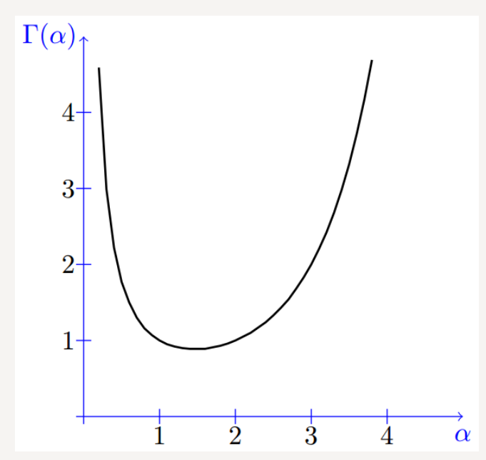
Gamma Random Variables
https://www.probabilitycourse.com/chapter4/4_2_4_Gamma_distribution.php

Slide 21
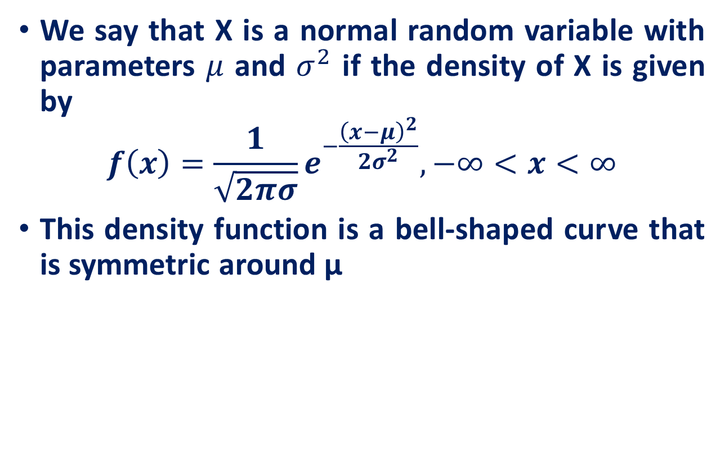
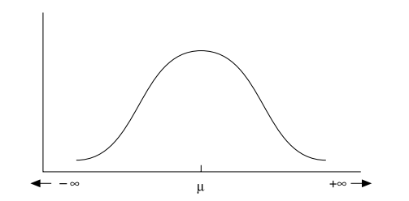
Normal Random Variables
https://www.probabilitycourse.com/chapter4/4_2_3_normal.php

Slide 22
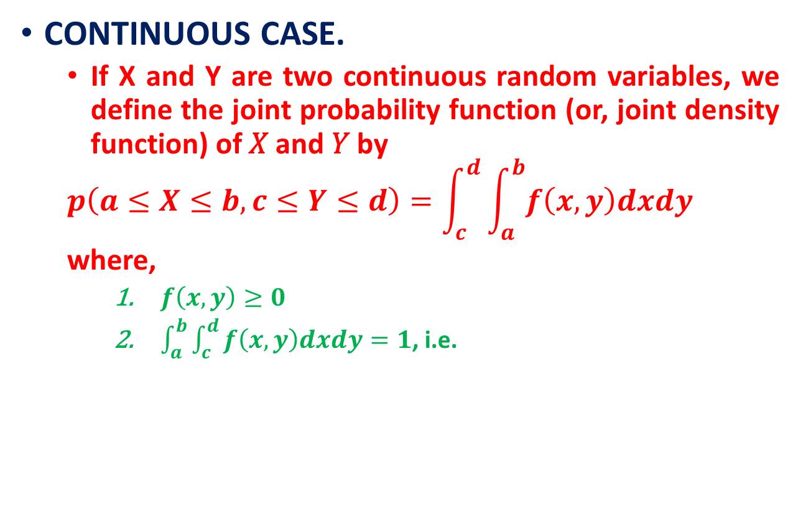
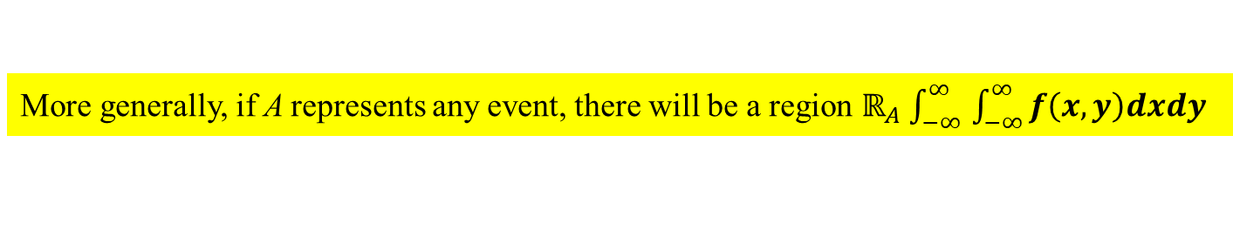
Joint Distributions

Slide 23
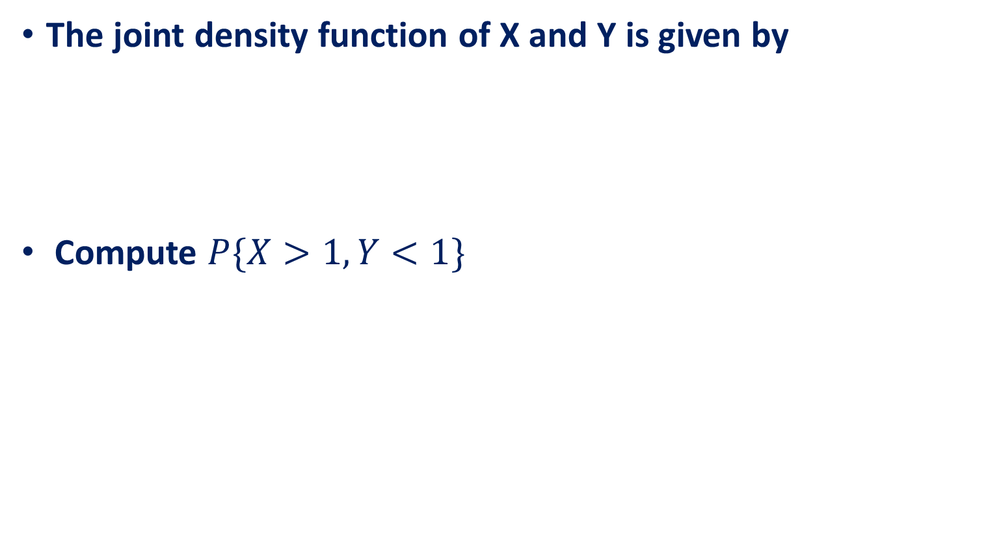

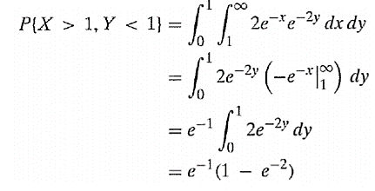
Joint Distributions

Slide 24
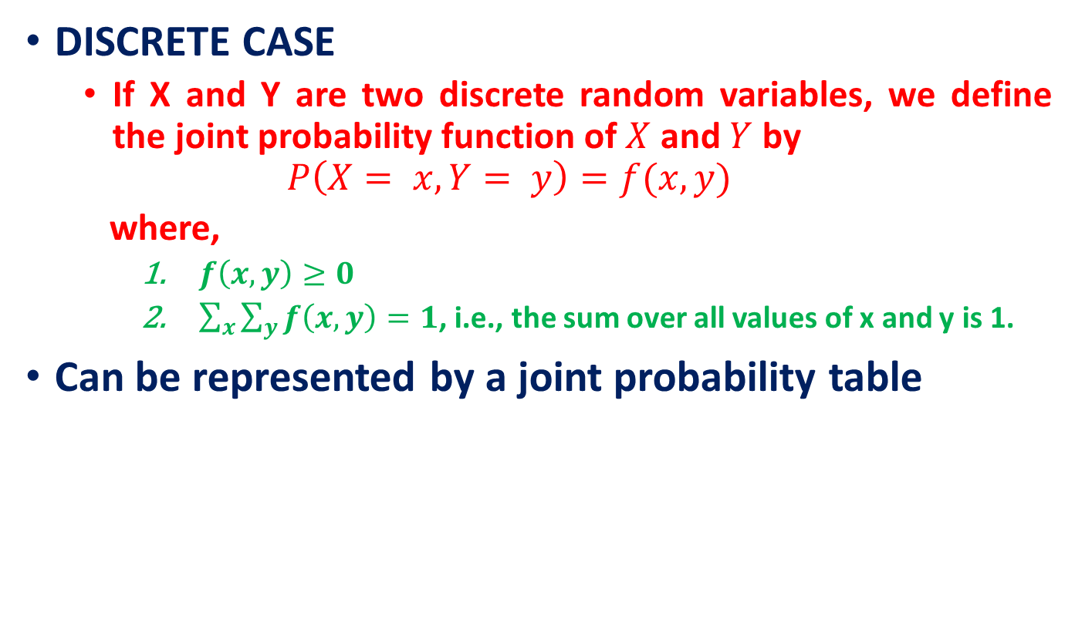
Joint Distributions
 |  | Throwing a Die
 |  | 1 | 2 | 3 | 4 | 5 | 6
Tossing a Coin | Head
 | Tail
Joint probability
Marginal probability

Slide 25
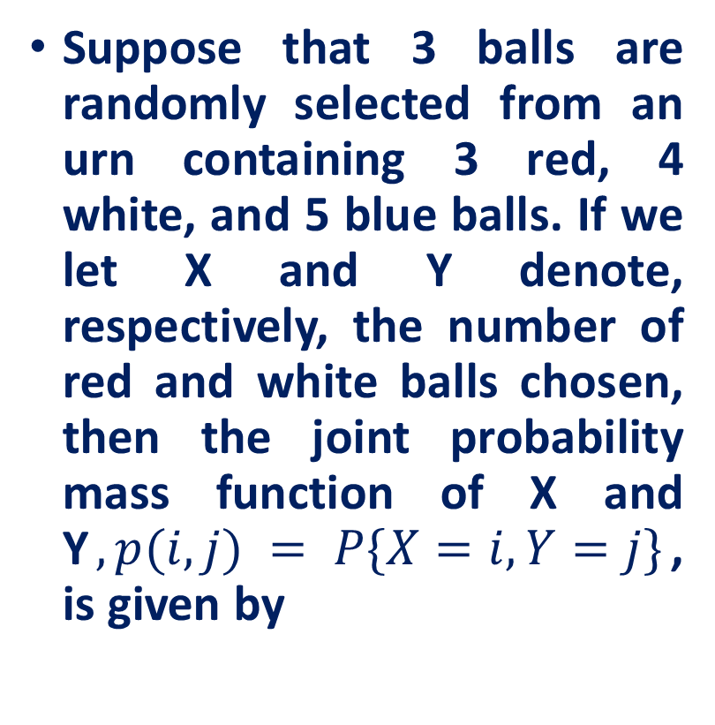
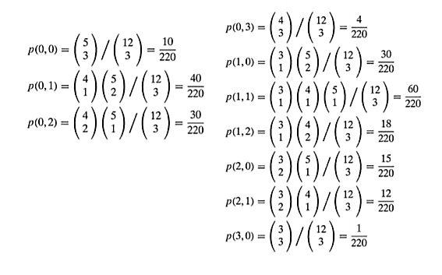
Joint Distributions

Slide 26
Reference
Lecture notes on Probability Theory by Phanuel Mariano
Introduction to Probability Models, Sheldon M. Ross, Tenth Edition

